Slide 1
機器學習基礎與演算法
Chapter 1 機器學習概論
Chapter 2 迴歸(Linear Regression)
講師投影片chapter 1
講師投影片chapter 2
影片播放清單

Slide 3

1. 機器學習概論
2. 迴歸 (Regression)
-Linear regression and closed-form
-Gradient descent
-One-hot encoding
-Overfitting, Ridge, Lasso, elastic-net
-Gd, sgd, and mini-batch-gd
課程內容

Slide 4

Chapter 1 機器學習概論
範例程式(example)的檔名會以藍色字體顯示且旁邊附上
練習(exercise)的檔案以紅色字體顯示且旁邊附上

Slide 5

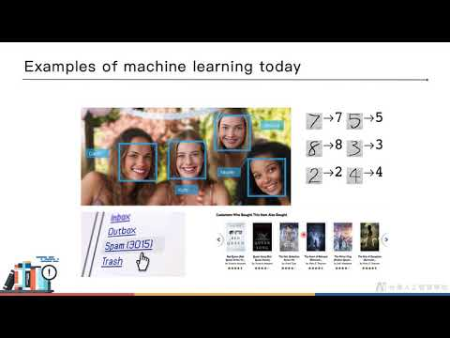
01-1: Introduction to machine learning

Slide 6
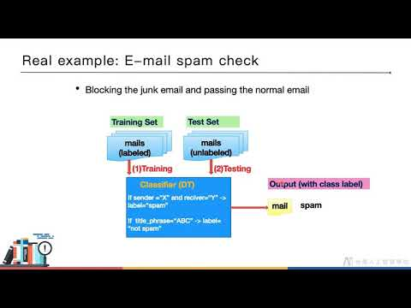
01-2: Introduction to supervised learning

Slide 7
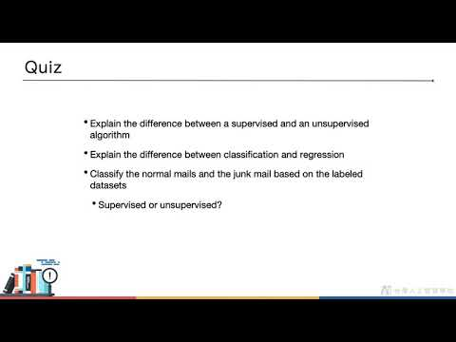
01-3: Quiz

Slide 8
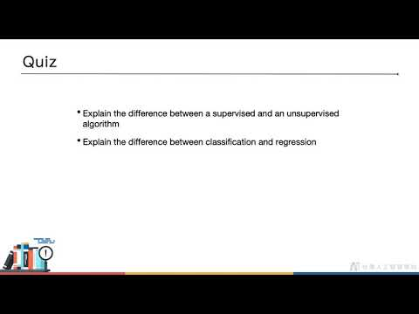
01-4: Answer

Slide 9
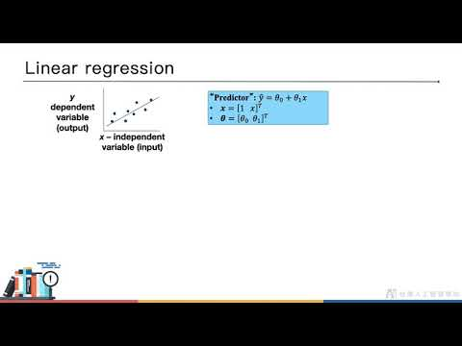
02-1: Introduction to regression

Slide 10
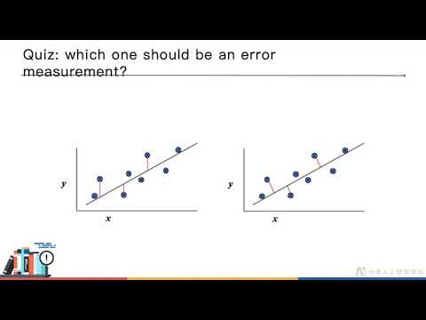
02-2: Quiz

Slide 11
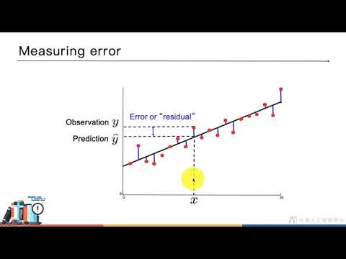
02-3: Answer

Slide 12
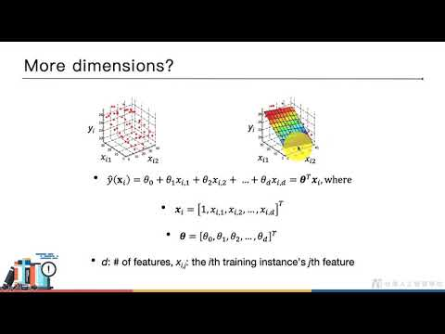
02-4: Linear regression and closed-form solution

Slide 13
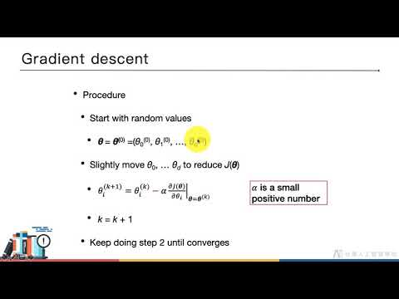
02-5: Gradient descent

Slide 14
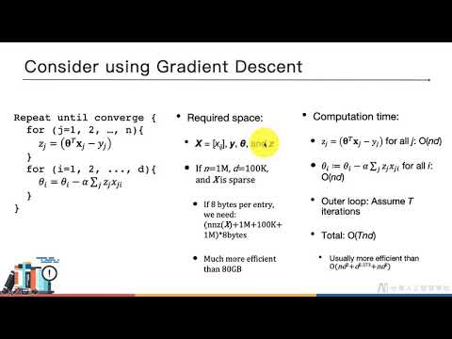
02-6: Closed-form vs gradient descent

Slide 15
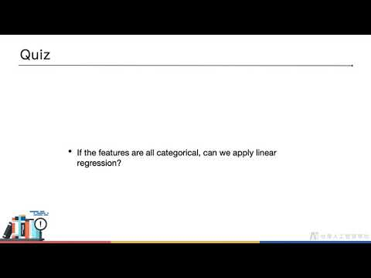
02-7: Quiz

Slide 16
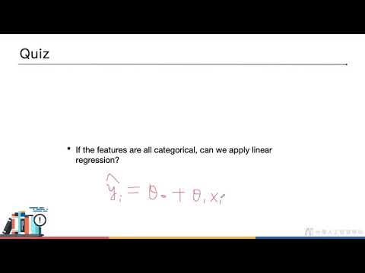
02-8: Answer

Slide 17
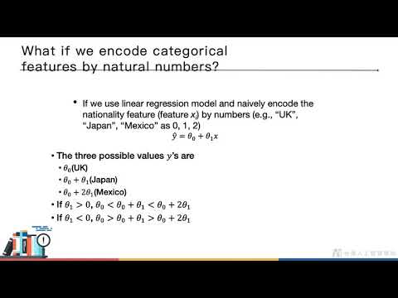
02-9: One-hot encoding

Slide 18
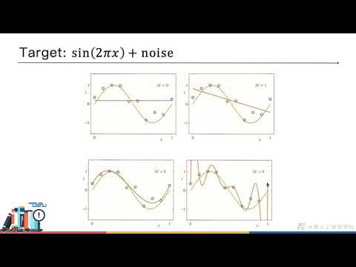
02-10: Overfitting, Ridge, Lasso, elastic-net

Slide 19
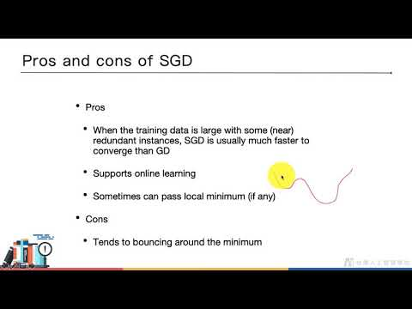
02-11: Gd, sgd, and mini-batch-gd

Slide 20
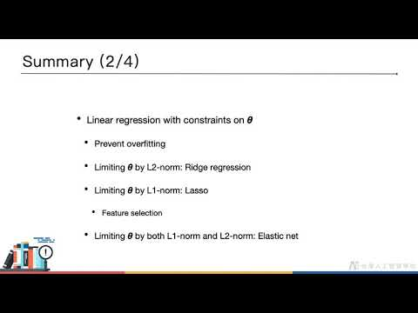
02-12: Summary

Slide 21
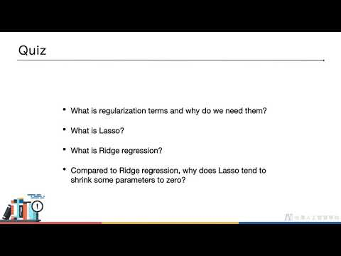
02-13: Quiz

Slide 22
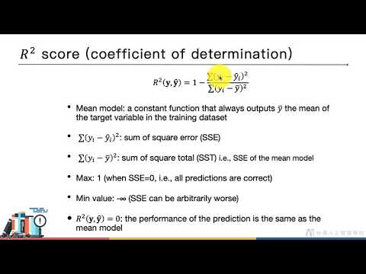
02-14: Evaluation (regression)

